Slide 1

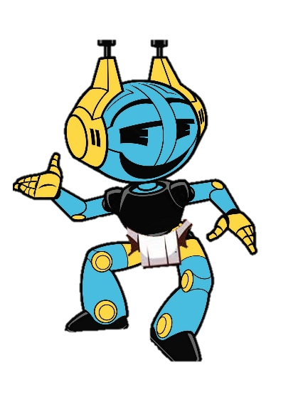
Robocup Junior S.A. Sumo Competition (getting started in EV3 classroom)
By Simon Coad - Chair Robocup Junior S.A. 2024
This training is the property of RCJSA and may not be reproduced or edited without written consent from RCJSA

Slide 2
What is RCJSA Sumo?
Robocup Junior South Australia (RCJSA) Sumo is a head to head competition where two autonomous robots try to push or flip the other out of a circular ring. The last robot remaining in the ring, or upright, wins the round. While pushing your opponent out of the ring is the most common way to win a round, disabling your opponent (flipping and lifting) is strongly encouraged. Winning the most rounds, wins the match.

Slide 3
Game play
The arena will be a circular ring 1000 to 1200 mm in diameter with a 50 mm white border around the ring’s perimeter
The challenge is broken up into 3 divisions: Featherweight / Standard / Heavyweight (check rules for the specifics)
A match consists of the best of 3 rounds lasting 5 minutes in total.
Each competition consists of round-robin matches, with the a finals series to determine the overall winner.

Slide 4
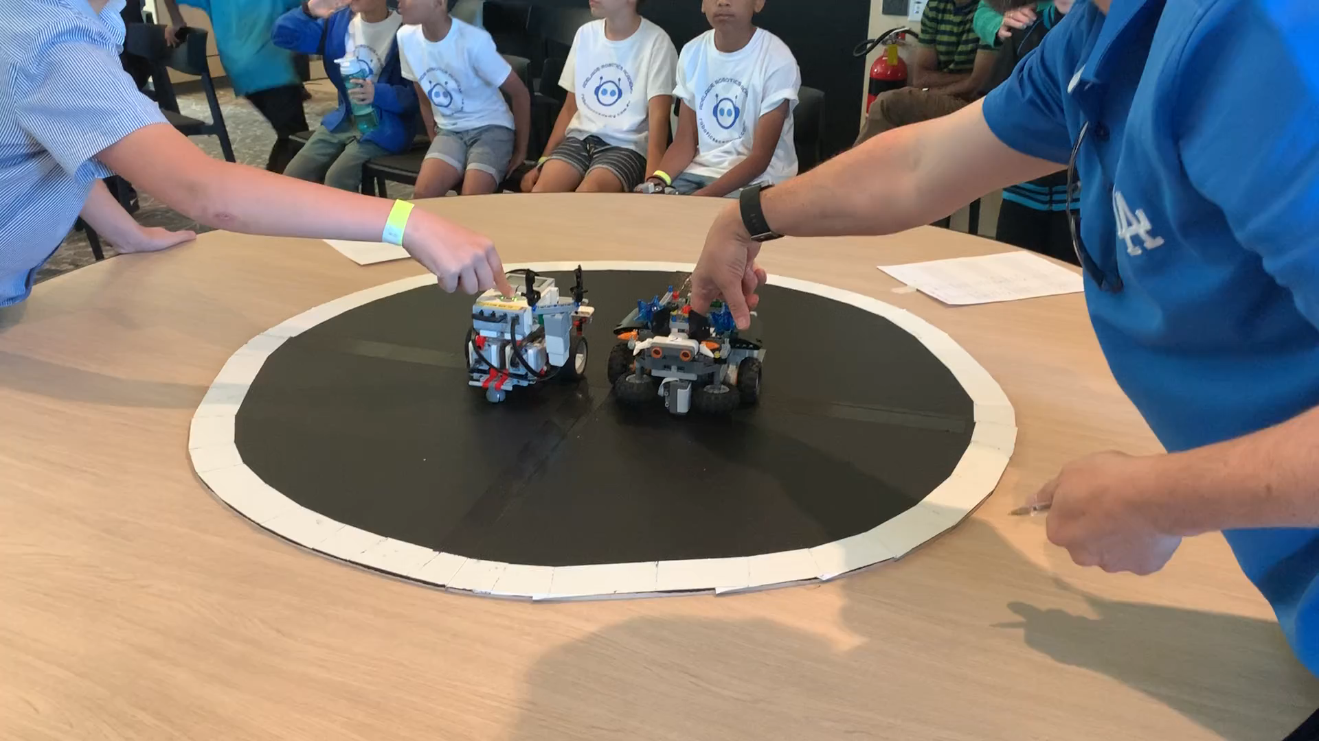
Sumo in action

Slide 5
Sumo in stages
Part 1 – create a simple program with a simple build (eg Riley Rover / 5 minute bot)
Part 2 – test your program to make sure it is successful
Part 3 – when you are happy with it, start redesigning your robot depending on your chosen competition (e.g. size / weight / correct number of sensors)
Part 4 – test your simple program with your new design and make adjustments to improve your program
Part 5 – download your program so you are ready to compete

Slide 6
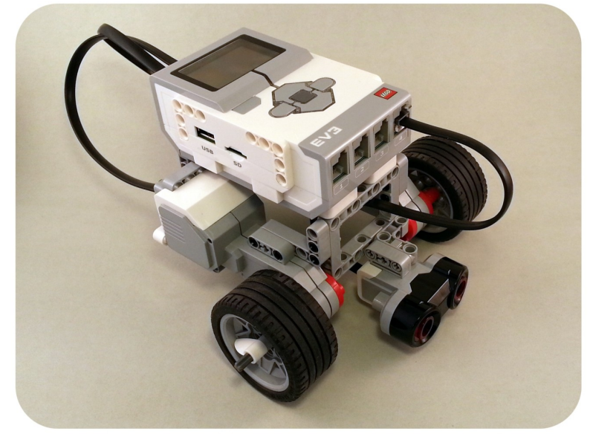
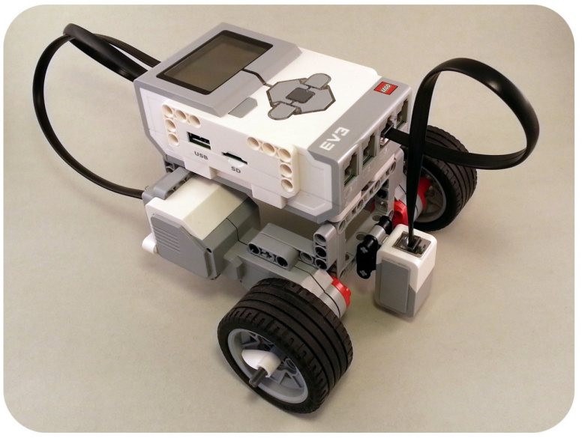
Part 1 - Simple Sumo build
https://www.damienkee.com/storage/rileyrover/RileyRover_BI.pdf
Light sensor
Ultrasonic sensor
These two sensors would allow you to compete right away.

Slide 7
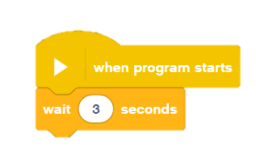
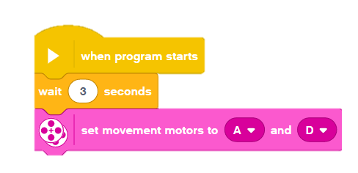
Part 1 - Simple Sumo program EV3 classroom (starting)
To start off, the robot must be designed to wait 3 seconds after the contestant presses a start button before it moves.
This is so you can move away before it begins
After this you need to set your motors (check to make sure your ports match the program)

Slide 8
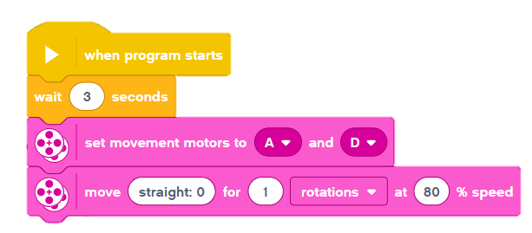
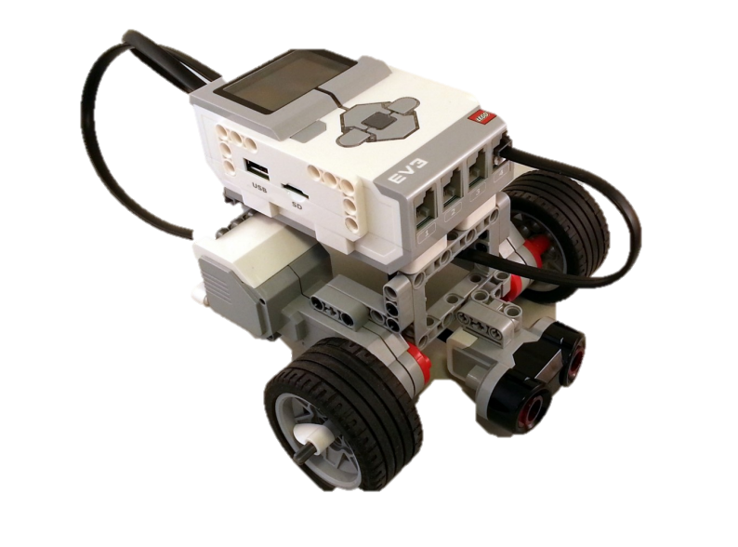
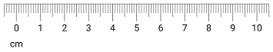
Part 1 - Simple Sumo program EV3 classroom (begin)
After the 3 second wait, the robot must begin a round by travelling forward at least 10cm away from the other sumo-bot
You will need to play with the speed / rotations / seconds so it goes 10cm
One good way is to draw a line of 10cm on your desk / floor and work on getting it accurate

Slide 9
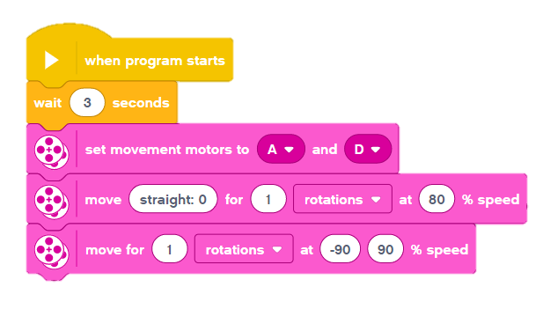
Part 1 - Simple Sumo program EV3 classroom (turning to opponent)
Once it has gone 10cm, we want it to turn back into the ring ready to face the other robot
The faster you can do this, the more advantage you will have to attack right away
Again you will need to play with speed / rotations to get it as best as you can

Slide 10
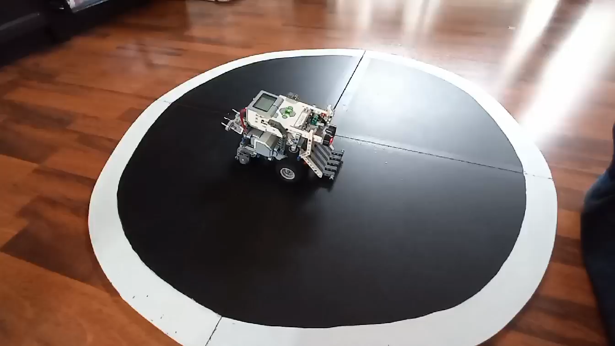
Part 1 - Simple Sumo program EV3 classroom (video example)

Slide 11
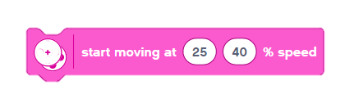
Part 1 - Simple Sumo program EV3 classroom (searching)
Next you need to start moving around the ring to look for your opponent
I have already said which motors are which earlier
It is important to have them at different speeds to create a circular motion around the ring
We don’t put seconds / rotations / degrees as we want to motors to be unlimited
If you change the speed of one wheel it will turn much faster

Slide 12
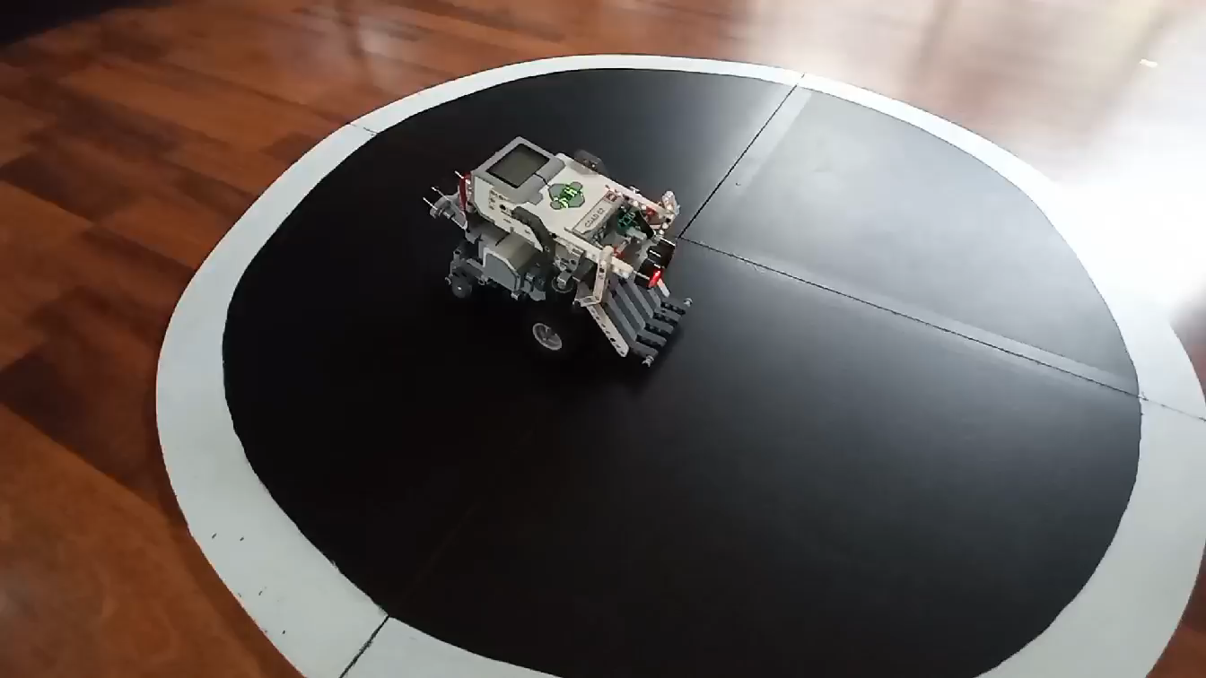
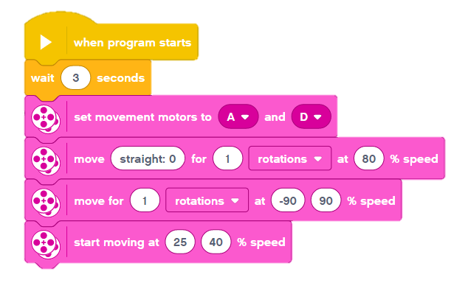
Part 1 - Simple Sumo program EV3 classroom (searching video)

Slide 13
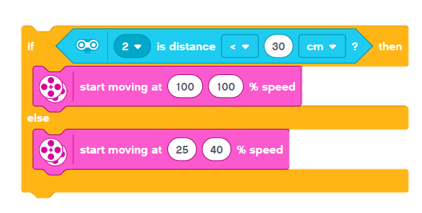
Part 1 - Simple Sumo program EV3 classroom (seek and destroy)
Once your moving you want to find the opponent
We call this program ‘seek and destroy’
Here we use an ‘if’ statement:
(if) the opponent come close to me I want to attack it. Otherwise I want to be searching around the ring until I can see my opponent.

Slide 14
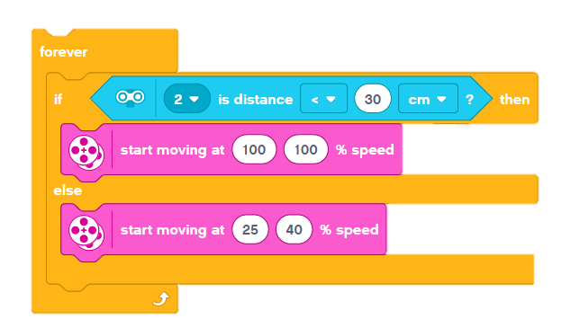
Part 1 - Simple Sumo program EV3 classroom (seek and destroy)
Put this in a forever loop so it will do it all the time
Make sure you have your ultrasonic sensor in the correct port otherwise it will not work

Slide 15
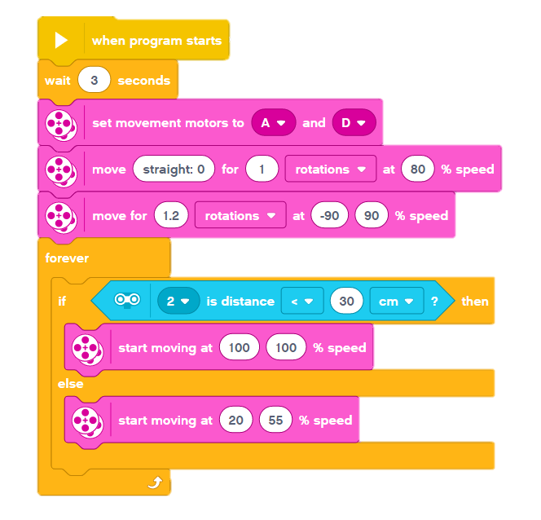
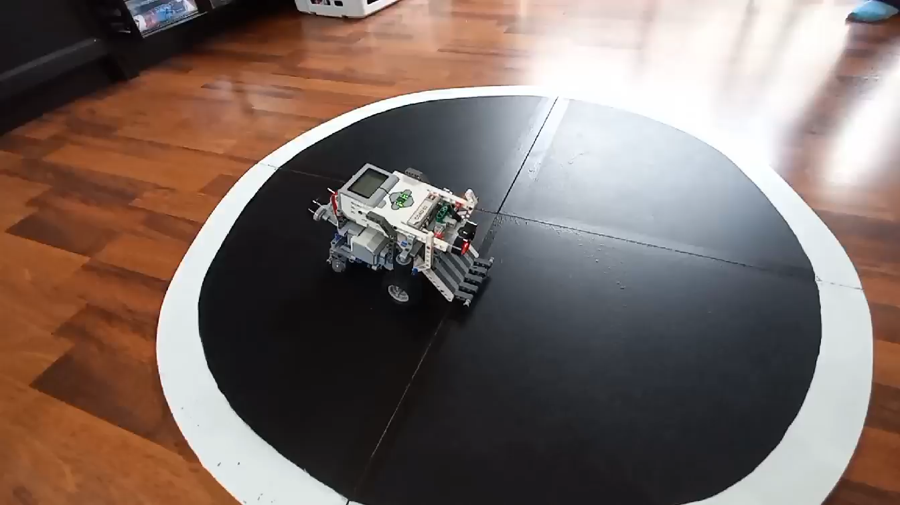
Part 1 - Simple Sumo program EV3 classroom (seek and destroy)
In action

Slide 16
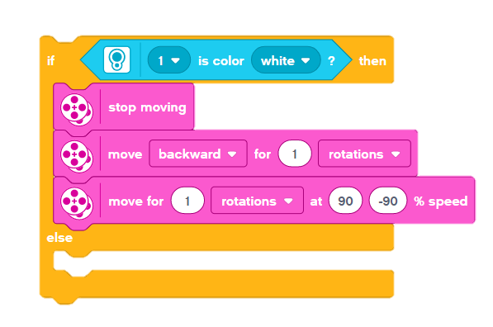
Part 1 - Simple Sumo program EV3 classroom (stop at the white line)
We still have the issue of it going off the field if it misses the opponent
We solve this by telling it to stop at the white boundary line, move back from the line and turning around to continue looking
This will help you stay in the contest longer
Don’t forget to make sure it is the right port number

Slide 17
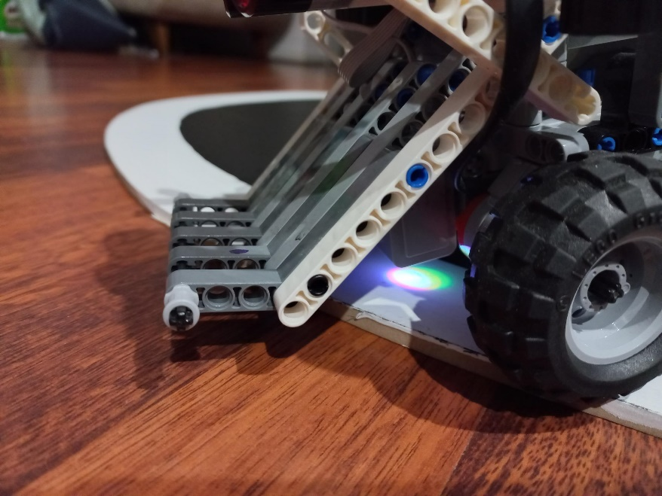
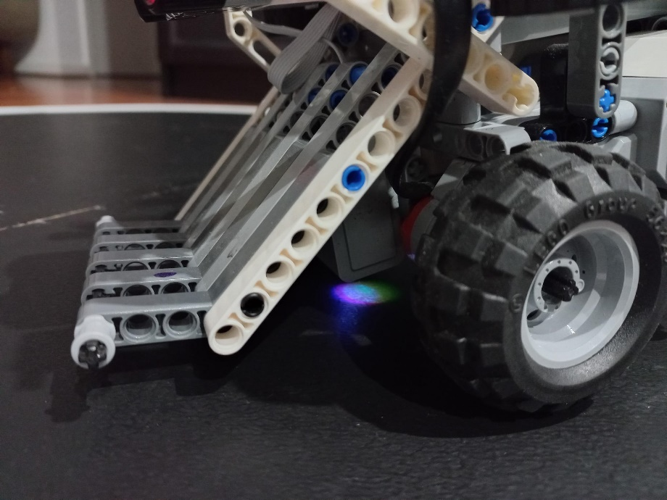


You can check if your robot sees white by putting it on the white line. If it sees white it will show up on your screen
If you put it on the black surface you will see it show a black circle.

Slide 18
Is it more accurate to read just colour or to look for a % of light?
By changing the light sensor to read % of light instead of colour, could you have your sumo robot react quicker to the line?
You will need to work on a formula of
(black + white) / 2

Slide 19
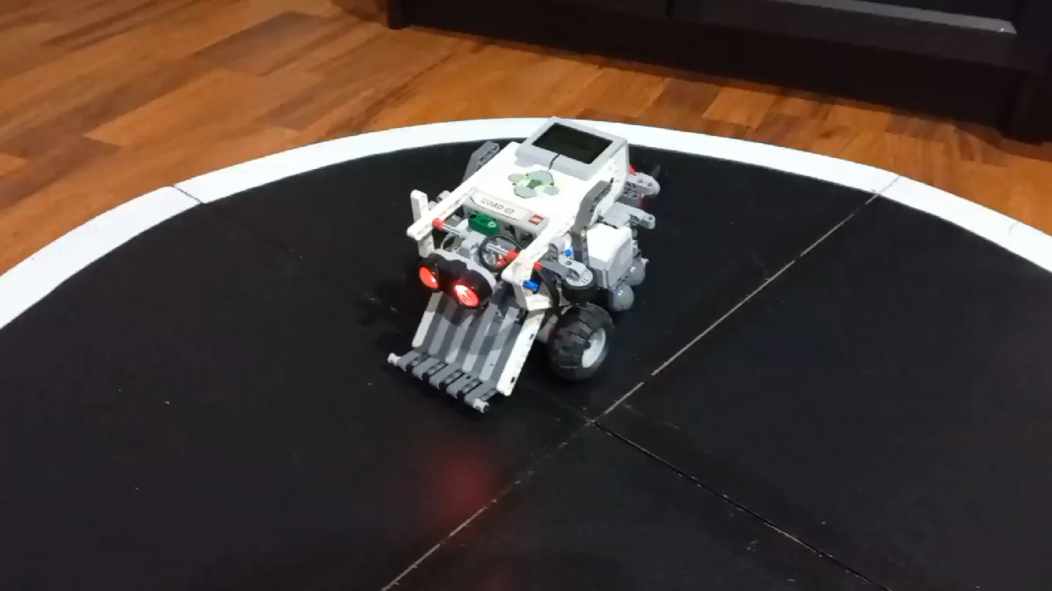
Part 1 - Simple Sumo program EV3 classroom (put it all together)
Light sensor working

Slide 20
Part 1 - Simple Sumo program EV3 classroom (put it all together)
Now put the ‘Seek and destroy’ program inside the ‘Stop at the line’ program and all inside a forever loop
The ‘stop at line’ part of your program needs to be what it looks for first because even if it is searching or attacking, if it sees the line it will run that program no matter what
You need to put all of this in a forever loop so the program will keep happening over and over again and not just once and then stop

Slide 21
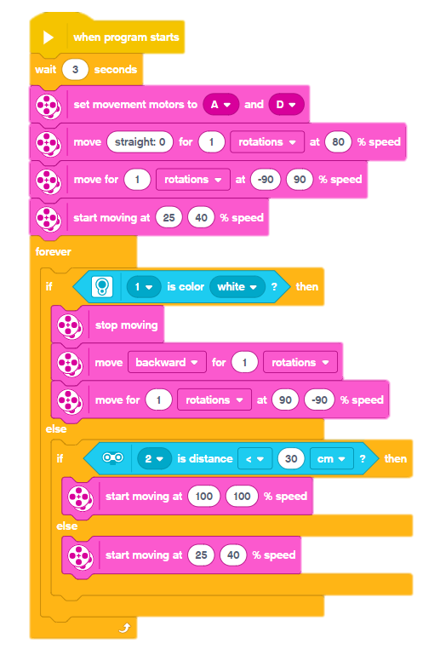
Part 1 - Simple Sumo program EV3 classroom (complete)
It should look something like this
Now test it and see how you go and make adjustments if you want it to go faster / turn quicker / move back from the line longer

Slide 22
Part 2 – test your program to make sure it is successful
It should:
- start after 3 seconds
- move forward 10cm
- turn back into the field (this will depend on which way it faces)
- start looking around for the opposition
- if it sees it inside ?cm then attack it
- if it does not see it, keep looking
- if it hits the white line – stop, move back and turn around and
search for your opponent

Slide 23
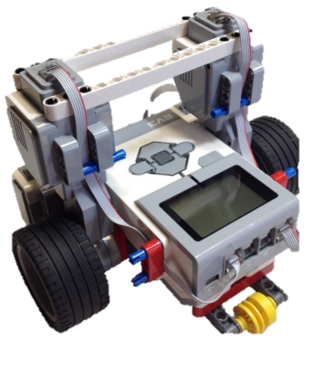
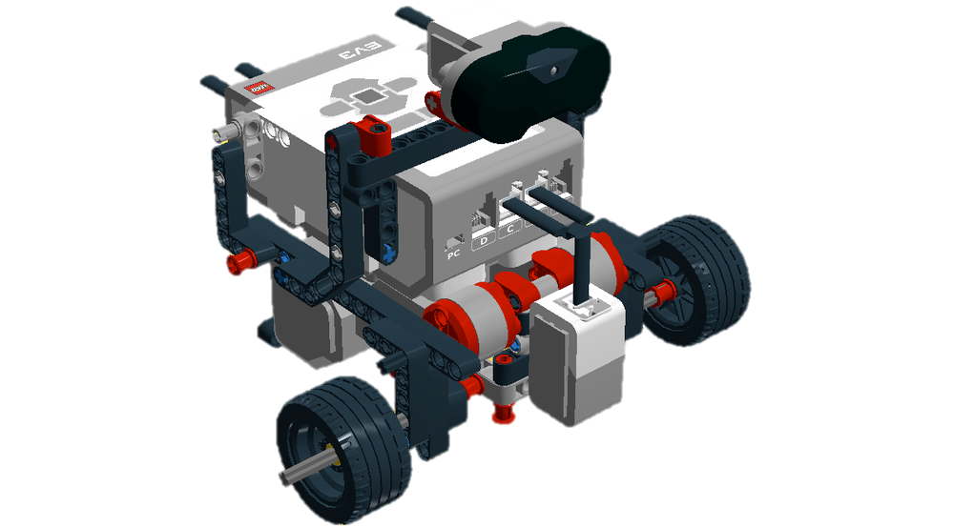
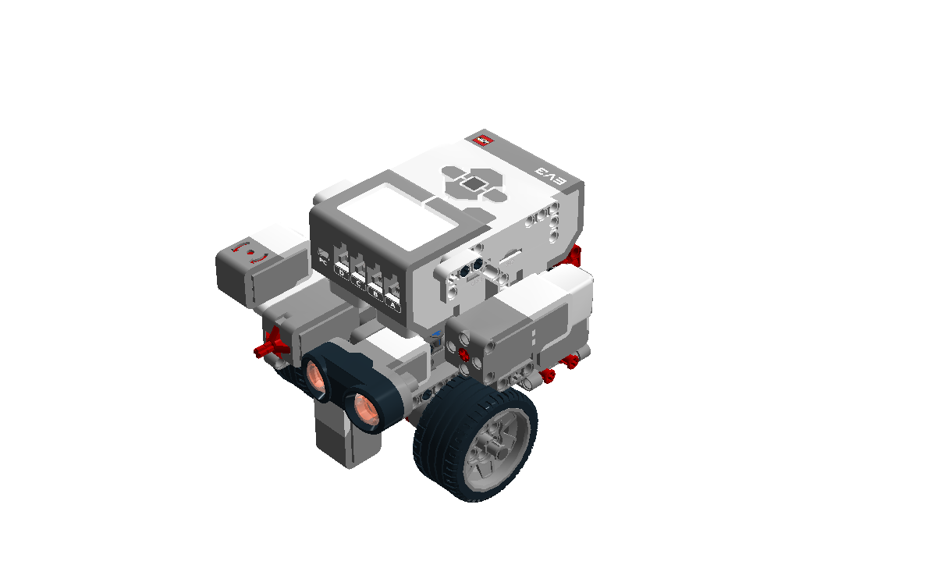
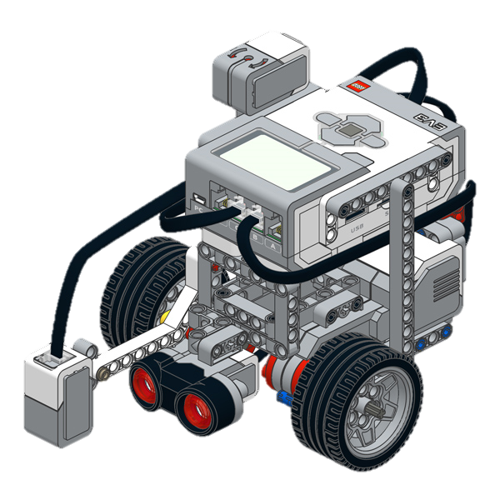
Part 3 – when you are happy with it start redesigning your robot depending on your chosen competition
Some websites to look at:
https://ev3lessons.com/en/RobotDesigns.html
http://www.sugobot.com/downloads/EV3/SSB-EV3.pdf
https://xtuml.github.io/sumo/sumo.html

Slide 24
Part 3 – when you are happy with it start redesigning your robot depending on your chosen competition
This also depends on which competition you are looking at . . .
- Lightweight Sumo
- Standard Sumo
- Heavyweight Sumo
(Check the website for rules and regulations for each division)

Slide 25
Part 4 – test your simple program with your new design and make any adjustments
Things to think about:
Could you make your turns quicker or more random?
Does your search section just go around in circles or is it covering all of the field?
Can you increase the speed of attack?
Does your robot see far enough to the other side of the field or is it seeing too much? (like a person and thinks it is the opponent)
How could you add a bump sensor on your robot and in your program (maybe another ‘if’ statement in your loop?
How do you make it heavier?
If you are in Standard or Heavyweight, where could you add another sensor (colour / ultrasonic) and how would you make those additions in your program

Slide 26

Part 5 – download your program and you are ready to compete
Have fun

Slide 27
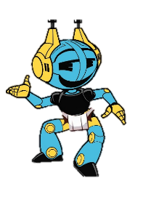
The match
How a match goes:
At the beginning of a round, the sumo-bots will be placed approximately 200 mm apart from each other in a parallel position. The sumo-bots must begin the round by moving in opposite directions.
The referee of the round will verify with the current contestants that their sumo-bots are positioned such that they will initially travelling in opposite directions.

Slide 28
The match
Start of a round:
When the referee signals the start of the match, one member of each team will start the robot.
Once the match has started, only the referee is allowed to touch the robots. Unless a restart is called
Your robot is out if it is flipped, can no longer move, falls out of the ring entirely or it loses more than 4 pieces
There are other things about the competition so it is important that you read the rules carefully with your mentors

Slide 29

Don’t forget to check out the official rules and competition events on our website
For more information go to
https://www.robocupjunior.org.au/challenge-regions/sa/
Or you can email me on
simon.coad@robocupjunior.org.au

